Slide 1
Data Structure and Algorithms
Lecture 9
Sorting

Slide 2
Sorting
Sorting is a process in which records are arranged in ascending or descending order
1 2 3 4 5 6
77
42
35
12
101
5
1 2 3 4 5 6
5
12
35
42
77
101

Slide 3
Types of sorting
Selection sort
Insertion sort
Bubble sort
Merge sort
Quick sort
Heap sort
Shell sort
Counting sort
Radix sort
https://visualgo.net/en/sorting
https://www.cs.usfca.edu/~galles/visualization/Algorithms.html

Slide 4
Selection Sort

Slide 5
Selection Sort
Selection sort is a sorting algorithm which works as follows:
  Find the minimum value in the list
  Swap it with the value in the first position
  Repeat the steps above for remainder of the list (starting at the second position)

Slide 6
Example: Selection Sort
26 33 43 100 46 88 52 17 53 77
17 | 33 43 100 46 88 52 26 53 77
17 26 | 43 100 46 88 52 33 53 77
17 26 33 | 100 46 88 52 43 53 77
17 26 33 43 | 46 88 52 100 53 77
17 26 33 43 46 | 88 52 100 53 77
17 26 33 43 46 52 | 88 100 53 77
17 26 33 43 46 52 53 | 100 88 77
17 26 33 43 46 52 53 77 | 88 100
17 26 33 43 46 52 53 77 88 | 100

Slide 7
Selection Sort
void selectionSort(int numbers[], int array_size) {
int i, j, T, min, count;
for (i = 0; i < array_size; i++) {
min = i;
for (j = i + 1; j < array_size; j++) {
if (numbers[j] < numbers[min]) {
min = j; }
}
T = numbers[min];
numbers[min] = numbers[i];
numbers[i] = T;
}
}

Slide 8
Time Complexity of Selection Sort
The total number of comparisons is :-
(N-1)+(N-2)+(N-3)+………… +1= N(N-1)/2
We can ignore the constant 1/2
We can express N(N-1) as N² – N
We can ignore N as well since N² grows more rapidly than N, making our algorithm O(N²)

Slide 9
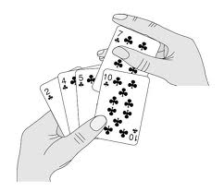

Insertion Sort

Slide 10
Insertion Sort
In insertion sort, each successive element in the array to be sorted is inserted into its proper place with respect to the other, already sorted elements.
We divide our array in a sorted and an unsorted array
Initially the sorted portion contains only one element: the first element in the array.
We take the second element in the array, and put it into its correct place

Slide 11
Insertion Sort
That is, array[0] and array[1] are in order with respect to each other.
Then the value in array[2] is put into its proper place, so array [0]…. array[2] is sorted and so on.
36
36
24
10
6
6
24
24
36
24
10
10
10
10
10
36
24
12
6
6
6
6
36
24
12
12
12
12
12
36

Slide 12
Insertion Sort
Our strategy is to search for insertion point from the beginning of the array and shift the element down to make room for new element
We compare the item at array[current] to one before it, and swap if it is less.
We then compare array[current-1] to one before it and swap if necessary.

Slide 13
Example: Insertion Sort
99 | 55 4 66 28 31 36 52 38 72
55 99 | 4 66 28 31 36 52 38 72
4 55 99 | 66 28 31 36 52 38 72
4 55 66 99 | 28 31 36 52 38 72
4 28 55 66 99 | 31 36 52 38 72
4 28 31 55 66 99 | 36 52 38 72
4 28 31 36 55 66 99 | 52 38 72
4 28 31 36 52 55 66 99 | 38 72
4 28 31 36 38 52 55 66 99 | 72
4 28 31 36 38 52 55 66 72 99 |

Slide 14
Insertion Sort Algorithm
void insertionSort(int array[], int length)
{
int i, j, value;
for(i = 1; i < length; i++)
{
value = a[i];
for (j = i - 1; j >= 0 && a[ j ] > value; j--)
{
a[j + 1] = a[ j ];
}
a[j + 1] = value;
}
}

Slide 15
Bubble Sort

Slide 16
Bubble Sort
Bubble sort is similar to selection sort in the sense that it repeatedly finds the largest/smallest value in the unprocessed portion of the array and puts it back.
However, finding the largest value is not done by selection this time.
We "bubble" up the largest value instead.

Slide 17
Bubble Sort
Compares adjacent items and exchanges them if they are out of order.
Comprises of several passes.
In one pass, the largest value has been “bubbled” to its proper position.
In second pass, the last value does not need to be compared.

Slide 18
Bubble Sort
Traverse a collection of elements
  Move from the front to the end
  “Bubble” the largest value to the end using pair-wise comparisons and swapping
1 2 3 4 5 6
77
42
35
12
101
5

Slide 19
Bubble Sort
Traverse a collection of elements
  Move from the front to the end
  “Bubble” the largest value to the end using pair-wise comparisons and swapping
Swap
1 2 3 4 5 6
42
77
77
42
35
12
101
5

Slide 20
Bubble Sort
Traverse a collection of elements
  Move from the front to the end
  “Bubble” the largest value to the end using pair-wise comparisons and swapping
1 2 3 4 5 6
Swap
35
77
42
77
35
12
101
5

Slide 21
Bubble Sort
Traverse a collection of elements
  Move from the front to the end
  “Bubble” the largest value to the end using pair-wise comparisons and swapping
1 2 3 4 5 6
Swap
12
77
42
35
77
12
101
5

Slide 22
Bubble Sort
Traverse a collection of elements
  Move from the front to the end
  “Bubble” the largest value to the end using pair-wise comparisons and swapping
1 2 3 4 5 6
42
35
12
77
101
5
No need to swap

Slide 23
Bubble Sort
Traverse a collection of elements
  Move from the front to the end
  “Bubble” the largest value to the end using pair-wise comparisons and swapping
1 2 3 4 5 6
Swap
5
101
42
35
12
77
101
5

Slide 24
Bubble Sort
Traverse a collection of elements
  Move from the front to the end
  “Bubble” the largest value to the end using pair-wise comparisons and swapping
1 2 3 4 5 6
101
42
35
12
77
5
Largest value correctly placed

Slide 25
Items of Interest
Notice that only the largest value is correctly placed
All other values are still out of order
So we need to repeat this process
1 2 3 4 5 6
101
42
35
12
77
5
Largest value correctly placed

Slide 26
Repeat “Bubble Up” How Many Times?
If we have N elements…
And if each time we bubble an element, we place it in its correct location…
Then we repeat the “bubble up” process N – 1 times.
This guarantees we’ll correctly place all N elements.

Slide 27
“Bubbling” All the Elements
1 2 3 4 5 6
42
35
12
77
5
101
1 2 3 4 5 6
35
12
42
5
77
101
1 2 3 4 5 6
N - 1
12
35
5
42
77
101
1 2 3 4 5 6
12
5
35
42
77
101
1 2 3 4 5 6
5
12
35
42
77
101

Slide 28
Reducing the Number of Comparisons
1 2 3 4 5 6
77
42
35
12
101
5
1 2 3 4 5 6
42
35
12
77
5
101
1 2 3 4 5 6
35
12
42
5
77
101
1 2 3 4 5 6
12
35
5
42
77
101
1 2 3 4 5 6
12
5
35
42
77
101

Slide 29
Already Sorted Collections?
What if the collection was already sorted?
What if only a few elements were out of place and after a couple of “bubble ups,” the collection was sorted?
We want to be able to detect this and “stop early”!
1 2 3 4 5 6
5
12
35
42
77
101

Slide 30
Using a Boolean “Flag”
We can use a boolean variable to determine if any swapping occurred during the “bubble up.”
If no swapping occurred, then we know that the collection is already sorted!
This boolean “flag” needs to be reset after each “bubble up.”

Slide 31
Bubble Sort Algorithm
void bubbleSort (int S[ ], int length) {
bool isSorted = false;
while(!isSorted)
{
isSorted = true;
for(int i = 0; i<length; i++)
{
if(S[i] > S[i+1])
{
int temp = S[i];
S[i] = S[i+1];
S[i+1] = temp;
isSorted = false;
}
}
length--;
}
}

Slide 32
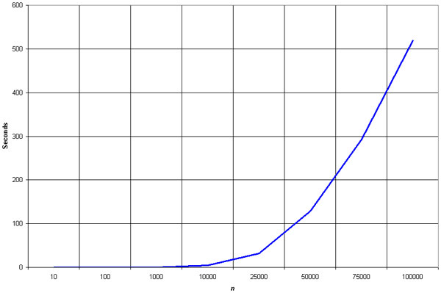
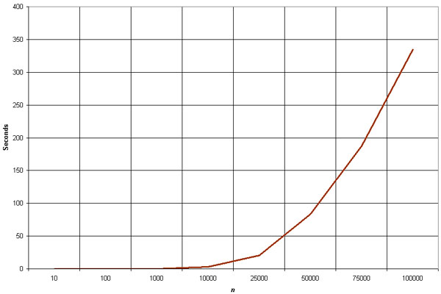
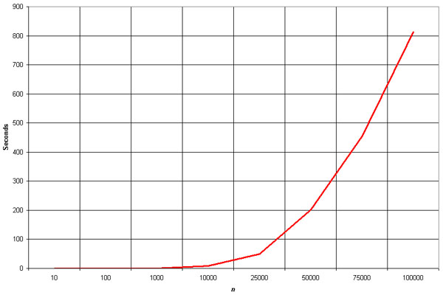
Insertion Sort
Selection Sort
Bubble Sort

Slide 33
Summary
The insertion sort is a good middle-of-the-road choice for sorting lists of a few thousand items or less.
The insertion sort is over twice as fast as the bubble sort and almost 40% faster than the selection sort. The insertion sort shouldn't be used for sorting lists larger than a couple thousand items or repetitive sorting of lists larger than a couple hundred items.

Slide 34
Mergesort

Slide 35
Divide and Conquer
Divide and Conquer cuts the problem in half each time, but uses the result of both halves:
  cut the problem in half until the problem is trivial
  solve for both halves
  combine the solutions

Slide 36
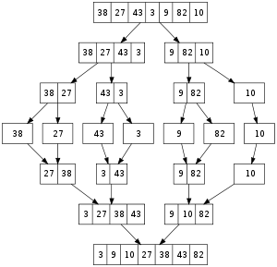
Merge Sort

Slide 37
Mergesort
A divide-and-conquer algorithm:
Divide the unsorted array into 2 halves until the sub-arrays only contain one element
Merge the sub-problem solutions together:
  Compare the sub-array’s first elements
  Remove the smallest element and put it into the result array
  Continue the process until all elements have been put into the result array
37
23
6
89
15
12
2
19

Slide 38
98
23
45
14
6
67
33
42

Slide 39
98
23
45
14
6
67
33
42
98
23
45
14
6
67
33
42

Slide 40
98
23
45
14
6
67
33
42
98
23
45
14
6
67
33
42
98
23
45
14

Slide 41
98
23
45
14
6
67
33
42
98
23
45
14
6
67
33
42
98
23
45
14
98
23

Slide 42
98
23
45
14
6
67
33
42
98
23
45
14
6
67
33
42
98
23
45
14
98
23
Merge

Slide 43
98
23
45
14
6
67
33
42
98
23
45
14
6
67
33
42
98
23
45
14
98
23
23
Merge

Slide 44
98
23
45
14
6
67
33
42
98
23
45
14
6
67
33
42
98
23
45
14
98
23
23
98
Merge

Slide 45
98
23
45
14
6
67
33
42
98
23
45
14
6
67
33
42
98
23
45
14
98
23
45
14
23
98

Slide 46
98
23
45
14
6
67
33
42
98
23
45
14
6
67
33
42
98
23
45
14
98
23
45
14
23
98
Merge

Slide 47
98
23
45
14
6
67
33
42
98
23
45
14
6
67
33
42
98
23
45
14
98
23
45
14
23
98
14
Merge

Slide 48
98
23
45
14
6
67
33
42
98
23
45
14
6
67
33
42
98
23
45
14
98
23
45
14
23
98
14
45
Merge

Slide 49
98
23
45
14
6
67
33
42
98
23
45
14
6
67
33
42
98
23
45
14
98
23
45
14
23
98
14
45
Merge

Slide 50
98
23
45
14
6
67
33
42
98
23
45
14
6
67
33
42
98
23
45
14
98
23
45
14
23
98
14
45
14
Merge

Slide 51
98
23
45
14
6
67
33
42
98
23
45
14
6
67
33
42
98
23
45
14
98
23
45
14
23
98
14
45
14
23
Merge

Slide 52
98
23
45
14
6
67
33
42
98
23
45
14
6
67
33
42
98
23
45
14
98
23
45
14
23
98
14
45
14
23
45
Merge

Slide 53
98
23
45
14
6
67
33
42
98
23
45
14
6
67
33
42
98
23
45
14
98
23
45
14
23
98
14
45
14
23
45
98
Merge

Slide 54
98
23
45
14
6
67
33
42
98
23
45
14
6
67
33
42
98
23
45
14
6
67
33
42
98
23
45
14
23
98
14
45
14
23
45
98

Slide 55
98
23
45
14
6
67
33
42
98
23
45
14
6
67
33
42
98
23
45
14
6
67
33
42
98
23
45
14
6
67
23
98
14
45
14
23
45
98

Slide 56
98
23
45
14
6
67
33
42
98
23
45
14
6
67
33
42
98
23
45
14
6
67
33
42
98
23
45
14
6
67
23
98
14
45
14
23
45
98
Merge

Slide 57
98
23
45
14
6
67
33
42
98
23
45
14
6
67
33
42
98
23
45
14
6
67
33
42
98
23
45
14
6
67
23
98
14
45
6
14
23
45
98
Merge

Slide 58
98
23
45
14
6
67
33
42
98
23
45
14
6
67
33
42
98
23
45
14
6
67
33
42
98
23
45
14
6
67
23
98
14
45
6
67
14
23
45
98
Merge

Slide 59
98
23
45
14
6
67
33
42
98
23
45
14
6
67
33
42
98
23
45
14
6
67
33
42
98
23
45
14
6
67
33
42
23
98
14
45
6
67
14
23
45
98

Slide 60
98
23
45
14
6
67
33
42
98
23
45
14
6
67
33
42
98
23
45
14
6
67
33
42
98
23
45
14
6
67
33
42
23
98
14
45
6
67
14
23
45
98
Merge

Slide 61
98
23
45
14
6
67
33
42
98
23
45
14
6
67
33
42
98
23
45
14
6
67
33
42
98
23
45
14
6
67
33
42
23
98
14
45
6
67
33
14
23
45
98
Merge

Slide 62
98
23
45
14
6
67
33
42
98
23
45
14
6
67
33
42
98
23
45
14
6
67
33
42
98
23
45
14
6
67
33
42
23
98
14
45
6
67
33
42
14
23
45
98
Merge

Slide 63
98
23
45
14
6
67
33
42
98
23
45
14
6
67
33
42
98
23
45
14
6
67
33
42
98
23
45
14
6
67
33
42
23
98
14
45
6
67
33
42
14
23
45
98
Merge

Slide 64
98
23
45
14
6
67
33
42
98
23
45
14
6
67
33
42
98
23
45
14
6
67
33
42
98
23
45
14
6
67
33
42
23
98
14
45
6
67
33
42
14
23
45
98
6
Merge

Slide 65
98
23
45
14
6
67
33
42
98
23
45
14
6
67
33
42
98
23
45
14
6
67
33
42
98
23
45
14
6
67
33
42
23
98
14
45
6
67
33
42
14
23
45
98
6
33
Merge

Slide 66
98
23
45
14
6
67
33
42
98
23
45
14
6
67
33
42
98
23
45
14
6
67
33
42
98
23
45
14
6
67
33
42
23
98
14
45
6
67
33
42
14
23
45
98
6
33
42
Merge

Slide 67
98
23
45
14
6
67
33
42
98
23
45
14
6
67
33
42
98
23
45
14
6
67
33
42
98
23
45
14
6
67
33
42
23
98
14
45
6
67
33
42
14
23
45
98
6
33
42
67
Merge

Slide 68
98
23
45
14
6
67
33
42
98
23
45
14
6
67
33
42
98
23
45
14
6
67
33
42
98
23
45
14
6
67
33
42
23
98
14
45
6
67
33
42
14
23
45
98
6
33
42
67
Merge

Slide 69
98
23
45
14
6
67
33
42
98
23
45
14
6
67
33
42
98
23
45
14
6
67
33
42
98
23
45
14
6
67
33
42
23
98
14
45
6
67
33
42
14
23
45
98
6
33
42
67
6
Merge

Slide 70
98
23
45
14
6
67
33
42
98
23
45
14
6
67
33
42
98
23
45
14
6
67
33
42
98
23
45
14
6
67
33
42
23
98
14
45
6
67
33
42
14
23
45
98
6
33
42
67
6
14
Merge

Slide 71
98
23
45
14
6
67
33
42
98
23
45
14
6
67
33
42
98
23
45
14
6
67
33
42
98
23
45
14
6
67
33
42
23
98
14
45
6
67
33
42
14
23
45
98
6
33
42
67
6
14
23
Merge

Slide 72
98
23
45
14
6
67
33
42
98
23
45
14
6
67
33
42
98
23
45
14
6
67
33
42
98
23
45
14
6
67
33
42
23
98
14
45
6
67
33
42
14
23
45
98
6
33
42
67
6
14
23
33
Merge

Slide 73
98
23
45
14
6
67
33
42
98
23
45
14
6
67
33
42
98
23
45
14
6
67
33
42
98
23
45
14
6
67
33
42
23
98
14
45
6
67
33
42
14
23
45
98
6
33
42
67
6
14
23
33
42
Merge

Slide 74
98
23
45
14
6
67
33
42
98
23
45
14
6
67
33
42
98
23
45
14
6
67
33
42
98
23
45
14
6
67
33
42
23
98
14
45
6
67
33
42
14
23
45
98
6
33
42
67
6
14
23
33
42
45
Merge

Slide 75
98
23
45
14
6
67
33
42
98
23
45
14
6
67
33
42
98
23
45
14
6
67
33
42
98
23
45
14
6
67
33
42
23
98
14
45
6
67
33
42
14
23
45
98
6
33
42
67
6
14
23
33
42
45
67
Merge

Slide 76
98
23
45
14
6
67
33
42
98
23
45
14
6
67
33
42
98
23
45
14
6
67
33
42
98
23
45
14
6
67
33
42
23
98
14
45
6
67
33
42
14
23
45
98
6
33
42
67
6
14
23
33
42
45
67
98
Merge

Slide 77
98
23
45
14
6
67
33
42
98
23
45
14
6
67
33
42
98
23
45
14
6
67
33
42
98
23
45
14
6
67
33
42
23
98
14
45
6
67
33
42
14
23
45
98
6
33
42
67
6
14
23
33
42
45
67
98

Slide 78
98
23
45
14
6
67
33
42
6
14
23
33
42
45
67
98

Slide 79
Algorithm
Mergesort(Passed an array)
if array size > 1
Divide array in half
Call Mergesort on first half.
Call Mergesort on second half.
Merge two halves.
Merge(Passed two arrays)
Compare leading element in each array
Select lower and place in new array.
(If one input array is empty then place
remainder of other array in output array)

Slide 80
Merge Sort
We don’t really pass in two arrays!
We pass in one array with indicator variables which tell us where one set of data starts and finishes and where the other set of data starts and finishes.
s1
f1
s2
f2

Slide 81
Merge Sort
void merge(int*,int*,int,int,int);
void mergesort(int *a, int*b, int low, int high) {
int pivot;
if(low<high) {
pivot=(low+high)/2;
mergesort(a,b,low,pivot);
mergesort(a,b,pivot+1,high);
merge(a,b,low,pivot,high);
}
}
int main() {
int a[] = {12,10,43,23,78,45,56,98,41,90,24};
int num; num = sizeof(a)/sizeof(int);
int b[num];
mergesort(a,b,0,num-1);
for(int i=0; i<num; i++) cout<<a[i]<<" "; cout<<endl; }

Slide 82
void merge(int *a, int *b, int low, int pivot, int high) {
int h,i,j,k; h=low; i=low; j=pivot+1;
while((h<=pivot)&&(j<=high)) {
if(a[h]<=a[j]) { b[i]=a[h]; h++; }
else { b[i]=a[j]; j++; }
i++; }
if(h>pivot) {
for(k=j; k<=high; k++) {
b[i]=a[k]; i++; } }
else {
for(k=h; k<=pivot; k++) {
b[i]=a[k]; i++; } }
for(k=low; k<=high; k++) a[k]=b[k]; }

Slide 83
Quicksort / partition-exchange sort
Quick sort is a divide and conquer algorithm.
Quick sort first divides a large list into two smaller sub-lists: the low elements and the high elements. Quick sort can then recursively sort the sub-lists.
The steps are:
1. Pick an element, called a pivot, from the list.
2. Reorder the list so that all elements with values less than the pivot come before the pivot, while all elements with values greater than the pivot come after it (equal values can go either way). After this partitioning, the pivot is in its final position. This is called the partition operation.
3. Recursively apply the above steps to the sub-list of elements with smaller values and separately the sub-list of elements with greater values.
The base case of the recursion are lists of size zero or one, which never need to be sorted.

Slide 84
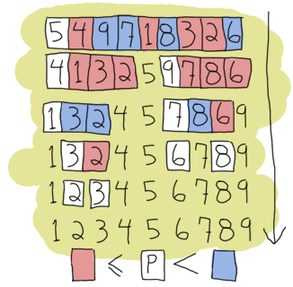
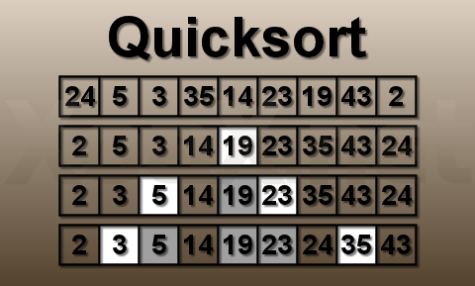
Quick Sort

Slide 85
Quick Sort
void quickSort(int a[], int first, int last);
int pivot(int a[], int first, int last);
void swap(int& a, int& b);
Void main()
{
int test[] = { 7, -13, 1, 3, 10, 5, 2, 4 };
int N = sizeof(test)/sizeof(int);
quickSort(test, 0, N-1);
}
void swap(int& a, int& b) {
int temp = a;
a = b;
b = temp;
}

Slide 86
void quickSort( int a[], int first, int last) {
int pivotElement;
if(first < last) {
pivotElement = pivot(a, first, last);
quickSort(a, first, pivotElement-1);
quickSort(a, pivotElement+1, last); }
}
int pivot(int a[], int first, int last){
int p = first;
int pivotElement = a[first];
for(int i = first+1 ; i <= last ; i++){
if(a[i] <= pivotElement){
p++;
swap(a[i], a[p]);
}
}
swap(a[p], a[first]);
return p;
}

Slide 87
int pivot(int a[], int first, int last){
int p = first;
int pivotElement = a[first];
for(int i = first+1 ; i <= last ; i++){
if(a[i] <= pivotElement){
p++;
swap(a[i], a[p]);
}
}
swap(a[p], a[first]);
return p;
}

Slide 88
Heap Sort
Heap sort is a comparison-based sorting technique based on Binary Heap data structure.
It is similar to selection sort where we first find the minimum element and place the minimum element at the beginning. We repeat the same process for the remaining elements.
Components:
Binary Heap
Heapify

Slide 89
Binary Heap
Let us first define a Complete Binary Tree. A complete binary tree is a binary tree in which every level, except possibly the last, is completely filled, and all nodes are as far left as possible.
A Binary Heap is a Complete Binary Tree where items are stored in a special order such that the value in a parent node is greater(or smaller) than the values in its two children nodes. The former is called max heap and the latter is called min-heap. The heap can be represented by a binary tree or array.
Since a Binary Heap is a Complete Binary Tree, it can be easily represented as an array and the array-based representation is space-efficient. If the parent node is stored at index I, the left child can be calculated by 2 * I + 1 and the right child by 2 * I + 2 (assuming the indexing starts at 0).

Slide 90
Heapify
The process of reshaping a binary tree into a Heap data structure is known as ‘heapify’. A binary tree is a tree data structure that has two child nodes at max. If a node’s children nodes are ‘heapified’, then only ‘heapify’ process can be applied over that node. A heap should always be a complete binary tree.
heapify(array)
Root = array[0]
Largest = largest( array[0] , array [2 * 0 + 1]. array[2 * 0 + 2])
if(Root != Largest)
Swap(Root, Largest)

Slide 91
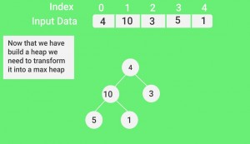
Example
Input: 4, 10, 3, 5, 1
1. Construct a binary heap (as per definition discussed).

Slide 92
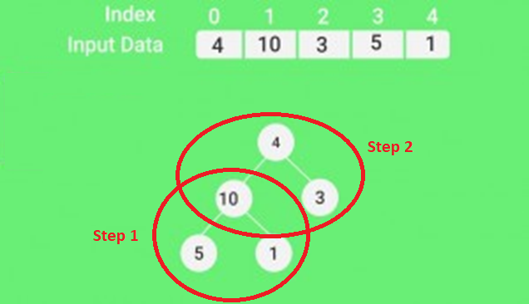
Contd.
2. Applying Heapify in a Bottom-up manner.

Slide 93
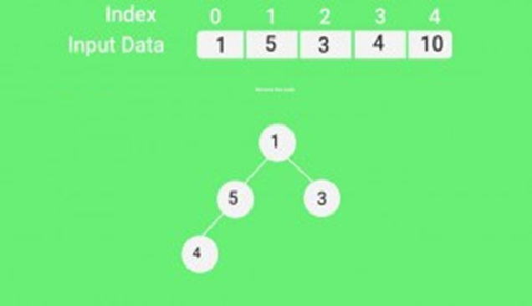
Contd.
Next, simply delete the root element (10) from the max heap. In order to delete this node, try to swap it with the last node, i.e. (1). After removing the root element, again heapify it to convert it into max heap.

Slide 94
Code
void heapify(int arr[], int n, int i) {
int largest = i;
int left = 2 * i + 1;
int right = 2 * i + 2;
if (left < n && arr[left] > arr[largest])
largest = left;
if (right < n && arr[right] > arr[largest])
largest = right;
if (largest != i) {
swap(&arr[i], &arr[largest]);
heapify(arr, n, largest);
}}

Slide 95
Contd.
void heapSort(int arr[], int n) {
for (int i = n / 2 - 1; i >= 0; i--)
heapify(arr, n, i);
for (int i = n - 1; i >= 0; i--) {
swap(&arr[0], &arr[i]);
heapify(arr, i, 0);
}
}

